Slide 1
How Our Students Benefit from a 1:1 Learning Environment
24/7 opportunities to engage in collaborative work
Ability to self-pace work, with access to richer information sources
Opportunities to organize and demonstrate knowledge and share with greater audiences

Slide 2
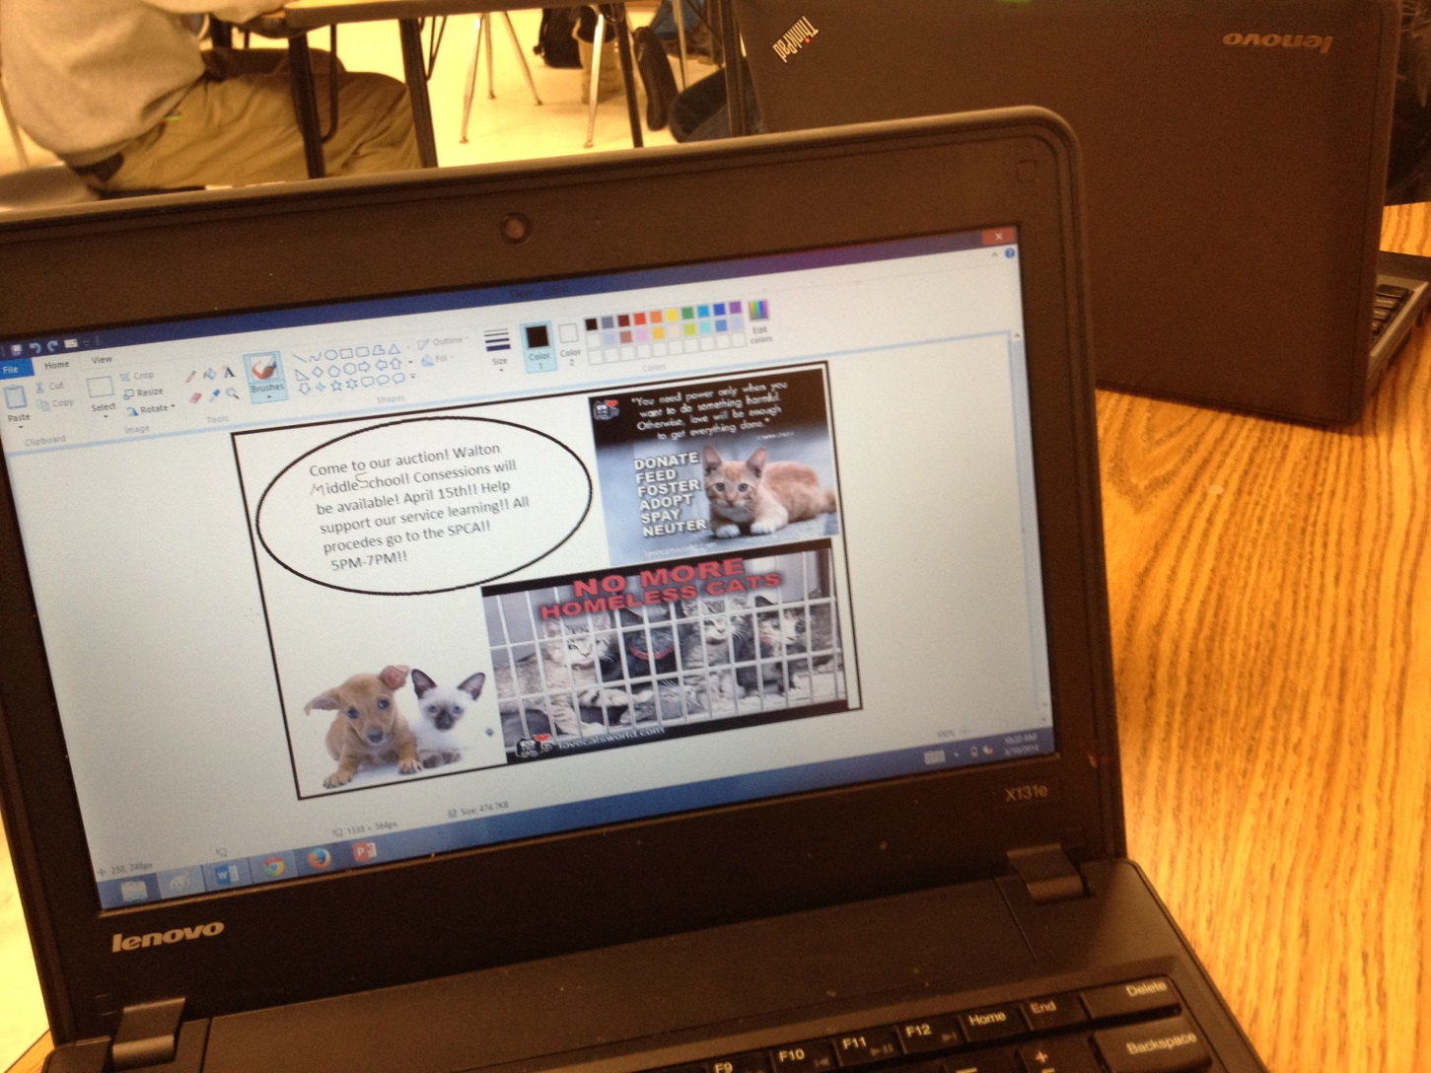
Sharing Student Work with a Greater Audience

Slide 3
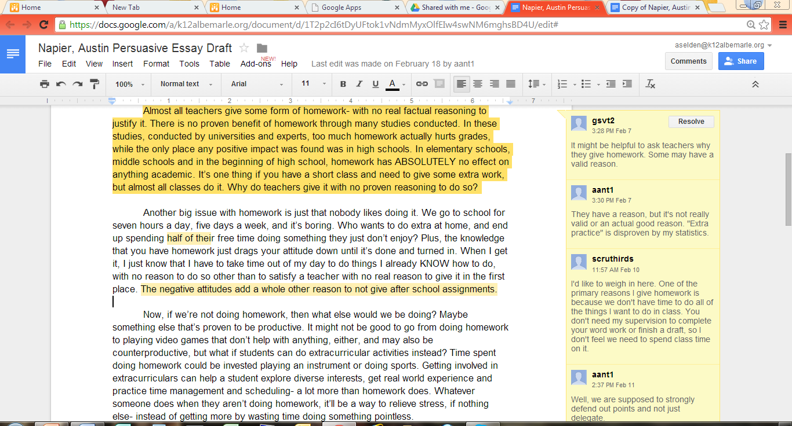
Collaboration

Slide 4
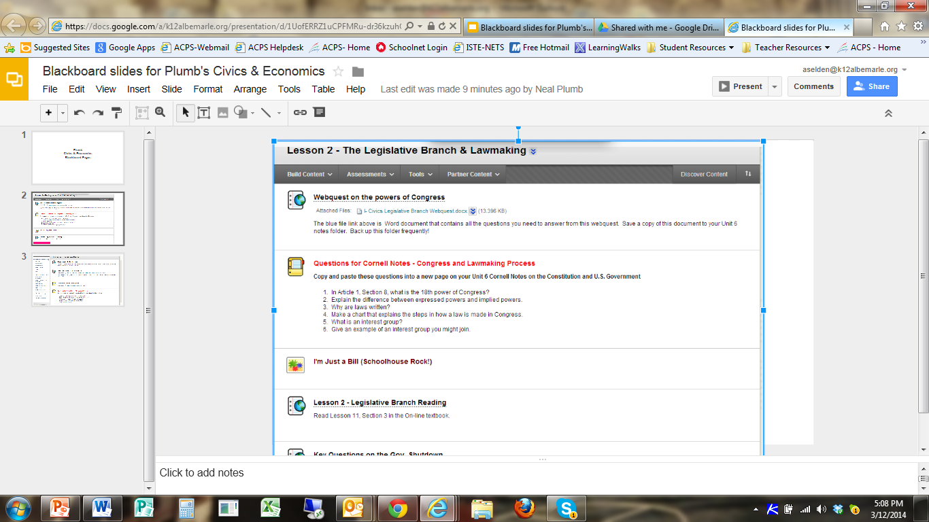
Richer Resources and Self-Pacing

Slide 5
Multi-Media

Slide 6
Lifelong Learner Standards
Acquire and use precise language to clearly communicate ideas, knowledge, and processes
Explore and express ideas and opinions using multimedia, the arts, and technology
Apply habits of mind and metacognitive strategies to plan, monitor, and evaluate one’s own learning

